Slide 1
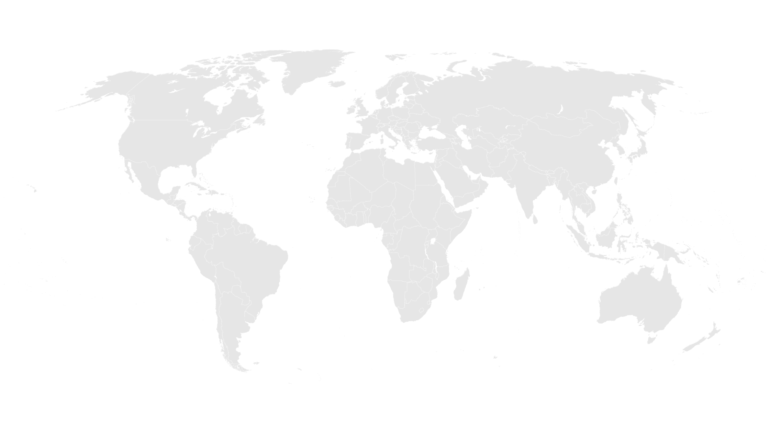
EAPLA Compact Portfolio Overview
August 2022

Slide 2
Portfolio Status as of September 2022
Implementation
Mongolia
Pre-EIF
Indonesia
Development
Nepal
Timor-Leste
Kosovo
Belize
Notes:
PRESENTER: Cameron

Slide 3
Mongolia Compact II
Implementation
Downstream wells
2 new wellfields downstream from city
Drill 30 wells, build pump stations, transmission line and storage tanks
Build water purification plant, as groundwater may contain contaminants
Up to 50 MCM of additional water each year
Size
$462 ($350M + $112M GOM funds)
Wastewater recycling
Replace freshwater used in two largest CHP plants
Construct recycling plant, transmission line, storage tanks, plant infrastructure
Requires consistent quality of effluent from CWWTP
“Free-up” approx. 14 MCM of water each year
Signed
July 27, 2018
EIF
March 31, 2021
CED
March 31, 2026
Water sector sustainability
Support policy, regulatory and institutional changes to sustain water supplies
Assist utility (USUG) to reduce costs, improve O&M
Complement plans to raise cost recovery, reduce industrial pollution
Increase long-term sustainability of benefits

Slide 4
Nepal Compact
Pre-Implementation
Electricity Transmission Project
New high voltage lines 1/3rd length of Nepal; increase power carrying capacity by ~5x
Increase cross-border power trade with India, regional integration
New regulator to improve sector governance
Size
$500M + $130M GON funds
Signed
September 14, 2017
EIF
August 2023
Road Maintenance Project
Improve maintenance planning and analytical skills
New road maintenance techniques and technology
MCC incentive matching fund to leverage Nepali funds

Slide 5
Timor-Leste Compact
Compact Development
Water, Sanitation, and Drainage (WSD) Project
Construction of a disinfection plant for provision of treated drinking water to Dili and four municipalities.
Development of the country’s first centralized wastewater collection and treatment system with ocean outfall and associated drainage.
Institutional strengthening and regulatory reform.
Household sanitation and water management social and behavior change.
Size
$420M + $64M GOTL funds
Signed
July 19, 2022
EIF target
July 2024
Teaching and Leading the Next Generation of Timorese (TALENT) Project
First formal pre-service certification and training institution established, Center of Excellence (CoE).
Development and deployment of training programs focused on pedagogy and leadership.
Improved access to secondary teaching and leadership positions for women.

Slide 6
Kosovo Compact
Compact Development
Energy Storage Project
Supports two battery systems. One battery system for automatic reserves to cost-effectively smooth out unexpected imbalances in the electricity grid. A second battery system for manual frequency restoration reserves, energy arbitrage, or other potential ancillary services, lowering the cost of ensuring grid stability, smoothing the way for the clean energy transition.
Additionally, a suite of policy and institutional reforms will support governance of the sector, facilitate the transition to a lower carbon economy, and address inequalities in access to benefits.
Just and Equitable Transition Acceleration Project
Creates new technical training programs focused on cultivating the skills required to meet the needs of the energy transition and support sustainability of MCC’s investments.
Incentivizes gender equitable practices in firms, support networking and mentoring opportunities for women, and facilitate energy and adjacent sector employers to increase female representation in the workplace.
Size
$202M + $34M GOK
funds
Signed
July 15, 2022
American Catalyst Facility for Development Project
Leverages United States International Development Finance Corporation financing to support a blended finance transaction(s) that will catalyze private investment in Kosovo to augment Compact initiatives under the Energy Storage Project.

Slide 7
Indonesia Compact II Target for Board Approval: End 2022
Compact Development
Strengthened Financial Intermediation for Transport and Logistics Infrastructure Project
Activities aim to improve integrated, multimodal transport planning and upstream infrastructure project preparation, structuring, procurement, and implementation at the subnational level
Physical good practice infrastructure projects are planned to serve as models of strengthened preparation processes and blended finance
Financial Markets Development Project
Technical assistance, capacity building, and transaction advisory activities to strengthen the enabling environment for limited recourse project finance on both sponsor and lender sides, as well as to involve capital markets more in infrastructure finance, including in areas of green bond/sukuk issuance and municipal finance
A blended finance delivery mechanism proposed to demonstrate pioneering limited recourse and blended project finance transactions
Size
$650M+ $TBDM GOI funds
Strengthened Financial Intermediation for (W)MSMEs Project
Activities aim to improve access to finance for growth-oriented (W)MSMEs by targeting information asymmetry between lenders and borrowers and perceptions of low borrower creditworthiness. Proposed activities include gender-inclusive value-chain/supply chain financing scheme, a digital literacy enhancement activity and MSME capacity enhancement activity.

Slide 8
Belize Compact
Compact Development
Constraints Analysis (CA) Findings
Country Team identified five binding constraints through a virtual technical visit and available data that was presented to MCC senior management on March 1. In April, the Government of Belize selected two constraints that would be subject to a Root Cause Analysis:
Education
High Cost of Electricity
Establishment of the Compact Development Team
The Government of Belize has contracted a Compact Development Team of nine consultants whose fees will be reimbursed by MCC under the Initial Engagement Agreement.
Size
$TBDM

